Slide 1
WELCOME
Notes:
This will be the Welcome screen.

Slide 2
Dunedin Plumbing Inc.
Notes:
This will contain Dunedin Plumbing logo, running plumber, and rushing water audio clip.

Slide 3
WHO WE ARE
We are Dunedin Plumbing, located on the Pinellas County side of the Tampa Bay area. Family-owned and operated since 1972.
We provide:
Complete plumbing repairs and services to residential and commercial customers
Courteous, efficient, and reliable service at very reasonable rates
Excellent plumbing service from our three generations of Master Plumbers

Slide 4
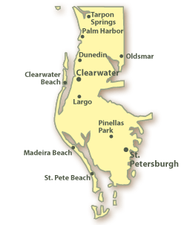
OUR SERVICE AREA

Slide 5
Need to replace that old, leaky water heater?

Slide 6
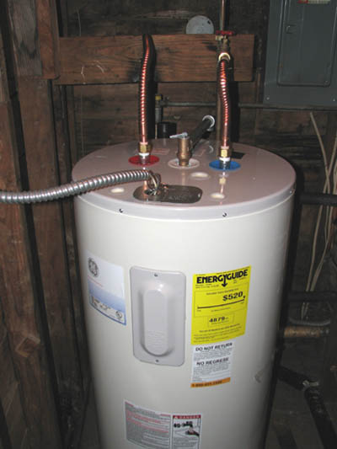
Let us replace it for you.

Slide 7
Is it time to replace that old, outdated sink and faucet?

Slide 8
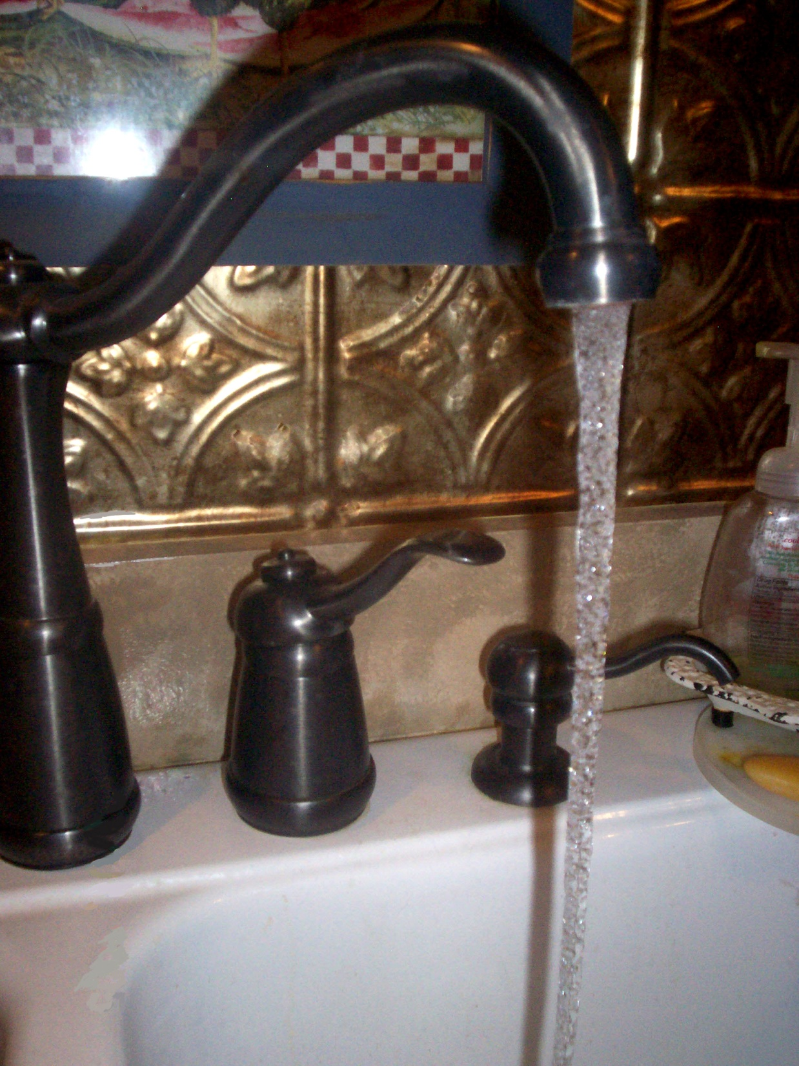
Let us do it for you.

Slide 9
Tired of looking at that ugly, old toilet bowl?

Slide 10
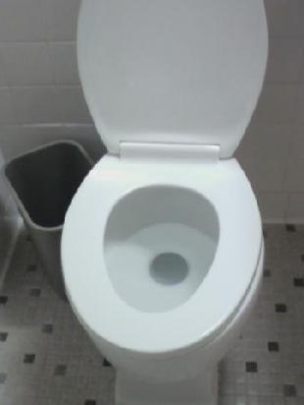
Let us install a new loo for you.

Slide 11
Sprung a leak under that slab?

Slide 12
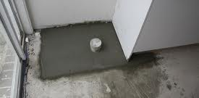
We will make it like new!

Slide 13
Got some serious pipe problems?

Slide 14
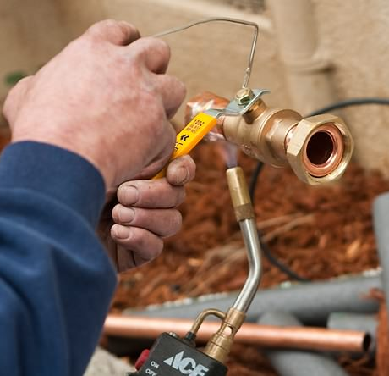
Our Master Plumbers are old hands at re-piping older homes.

Slide 15
Feel like you are up the creek without a paddle?

Slide 16
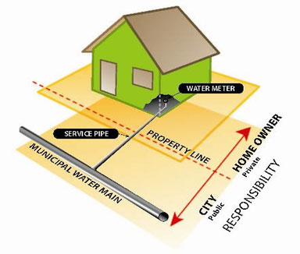
We are experts at getting main water line breaks under control!

Slide 17
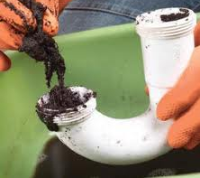
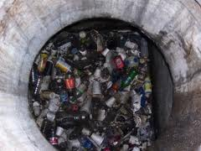
Clogged drains?
Sewer
backed up?

Slide 18
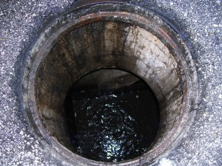
We’ll clean ‘em out for you!

Slide 19
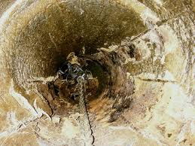
Sewer line blocked?

Slide 20
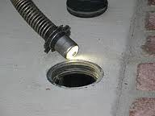
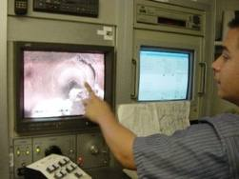
We will get to the root of the problem through use of our video camera snakes.

Slide 21
Why settle for this???

Slide 22
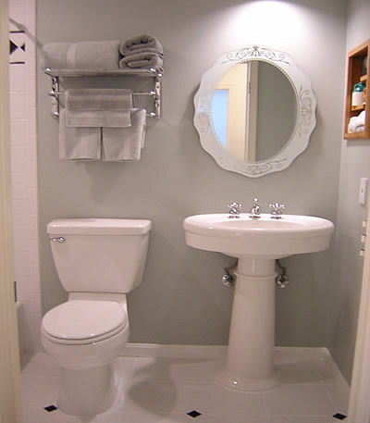
If you could have this!!!

Slide 23
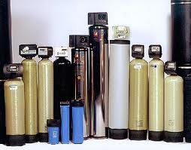
We sell and service Water Softeners!

Slide 24
That can turn hard water into something delightful!

Slide 25
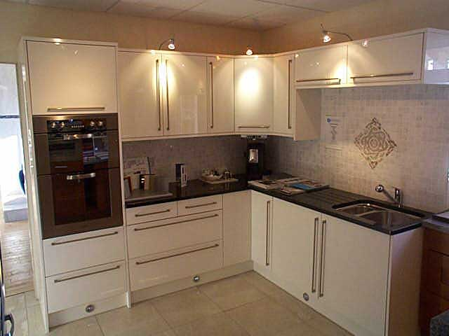
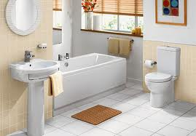
Come visit our Kitchen and Bath Showroom!

Slide 26
Call us for a free estimate on your kitchen or bath remodel!!!

Slide 27
OUR SERVICES
REPAIR:
Faucets & toilets
Water Heaters
Slab Leaks
REPLACE:
Faucets & toilets
Water Heaters
Main Water Line Service
Sewer Lines
Notes:
As you can see from the previous slides, we provide the following services…

Slide 28
OUR SERVICES
OTHER:
Re-pipe your House
Clean your Drains
Clean your Sewer Lines
Snake cameras through your Sewer Lines
MISCELLANEOUS:
Water Softener Sales & Service
Kitchen & Bathroom Showroom

Slide 29
PRODUCT LINE
Full manufacturer warranty on ALL products
Most service work is covered by our own one-year warranty

Slide 30
WE DO IT FASTER!
Notes:
This chart doesn’t really fit in with my presentation, but it’s here because it’s a requirement of the project. - cpkaye

Slide 31
DUNEDIN PLUMBING, INC.
483 Patricia Avenue
Dunedin, FL 34698
727-734-2879
Email: dunedinplumbing@aol.com
Web: www.dunedinplumbing.com
License #: CFC1426256
24/7 EMERGENCY INFORMATION
727-734-2879

