Slide 3
From Earth to Mars…
Ah, the beauty of Mother Earth. Only a privileged few have been lucky to view her—in all her majestic glory—from the heavens high above. The crew gazes momentarily at her splendor, then quickly return to their tasks….
Notes:
Let slide play for at least 10 seconds; the 1st audio clip takes a while before “speaking”.

Slide 4
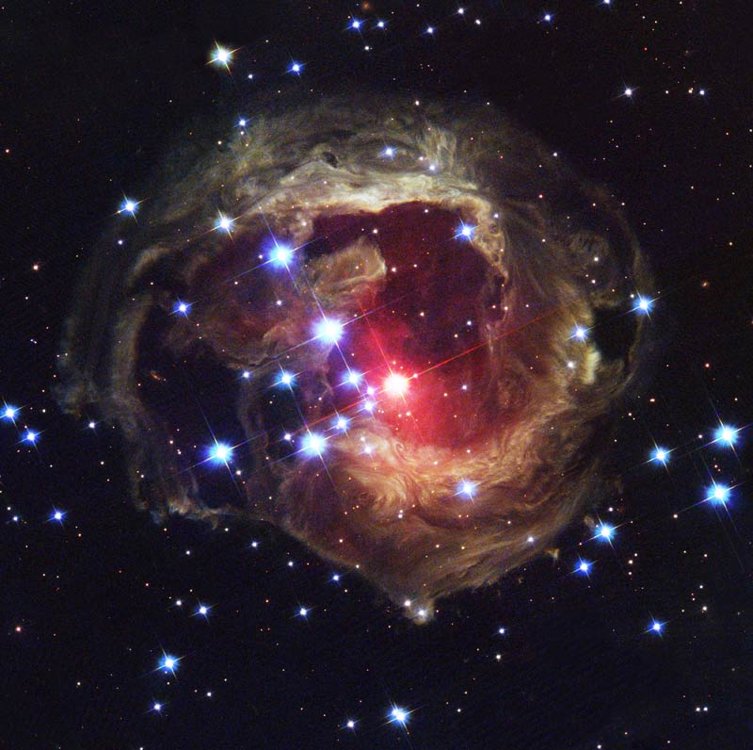

Slide 5
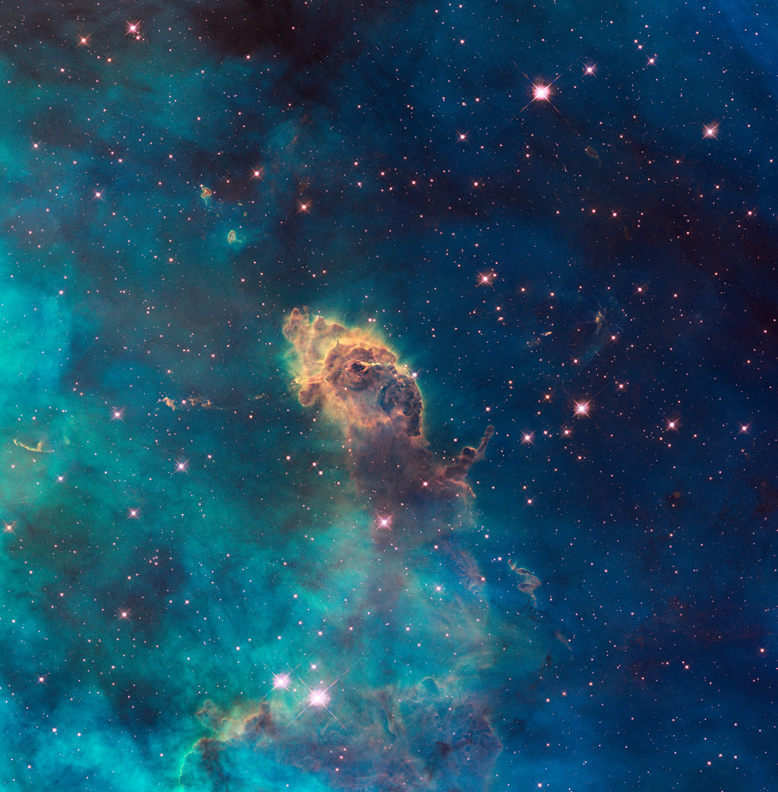

Slide 6
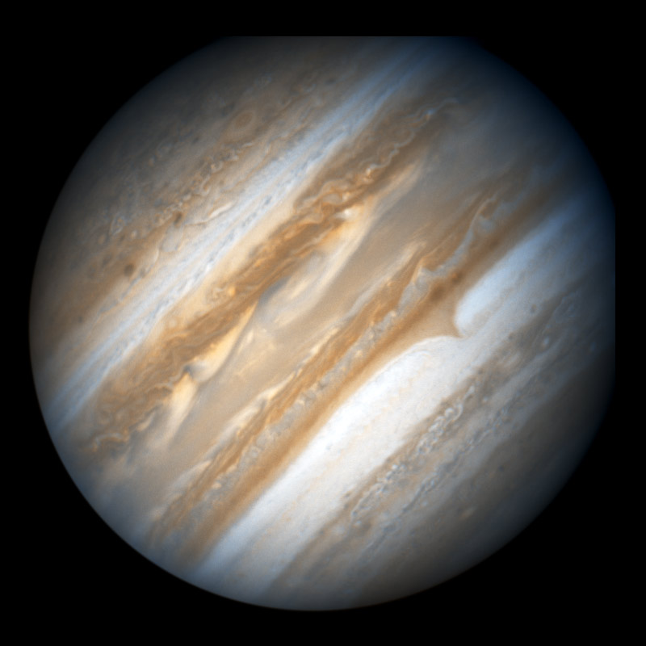

Slide 7
